Slide 1

Hunting for the Portable Pleasure Hunters
By Nancy Amandi
Courtesy: Data Analytics Super League(Lighthall)

Slide 2
Hello Julia,
I’ll be leading you through this report that exposes some loopholes in our business and the possible reasons they are happening.
At the end of this report, you’ll also understand the different customer segments in our business and their purchasing behavior.

Slide 3
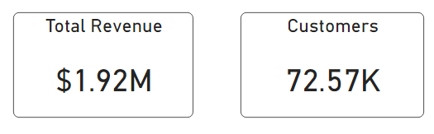
Revenue and customer size are fair
Approximately 73,000 unique customers have brought in 1.92 million dollars into the business.
Could this be a good, bad or fair figure? Let’s find out.

Slide 4
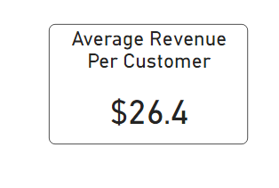
The revenue from customers might just be fair
Each customer have brought an average of 26 dollars into the business. The evaluation of this metric could be relative to the growth of revenue per customer by year.
Let’s find out if the revenue per customer grows by year.

Slide 5
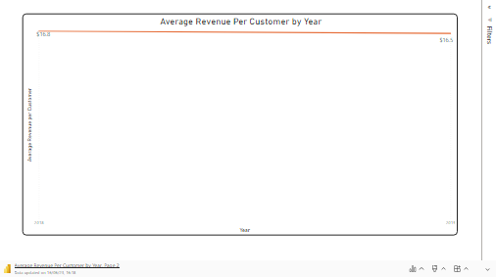
Customer revenue growth is negative
Unfortunately, revenue per customer grew less from 2018 to 2019.
Does this also affect the total revenue growth?

Slide 6
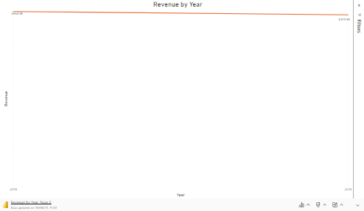
Revenue growth is disappointing
Average customer revenue grew less by year. Hence, the total revenue also went negative.
Could it also be that customers are also leaving the business?

Slide 7
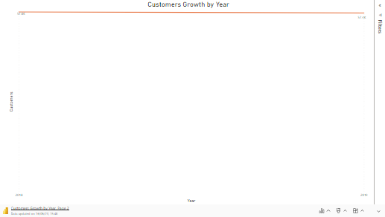
Customers are abandoning us
Approximately 400 customers are no longer with us for over a year.
The problem is, who are these leaving customers and why are they leaving?

Slide 8
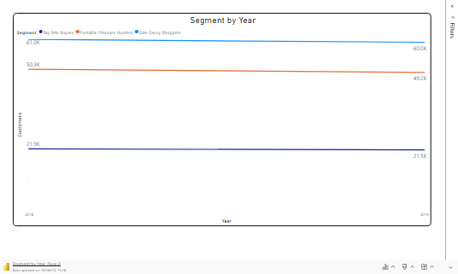
Portable Pleasure Hunters are leaving fast
About 2.2% of customers in the Portable Pleasure Hunters have stopped hunting for our products within a year. While 1.7% of the Big Bite Buyers and Size Savvy Shoppers are no longer shopping with us.
Now we know the most leaving customer category, let’s get into the description of these customer segments.

Slide 9
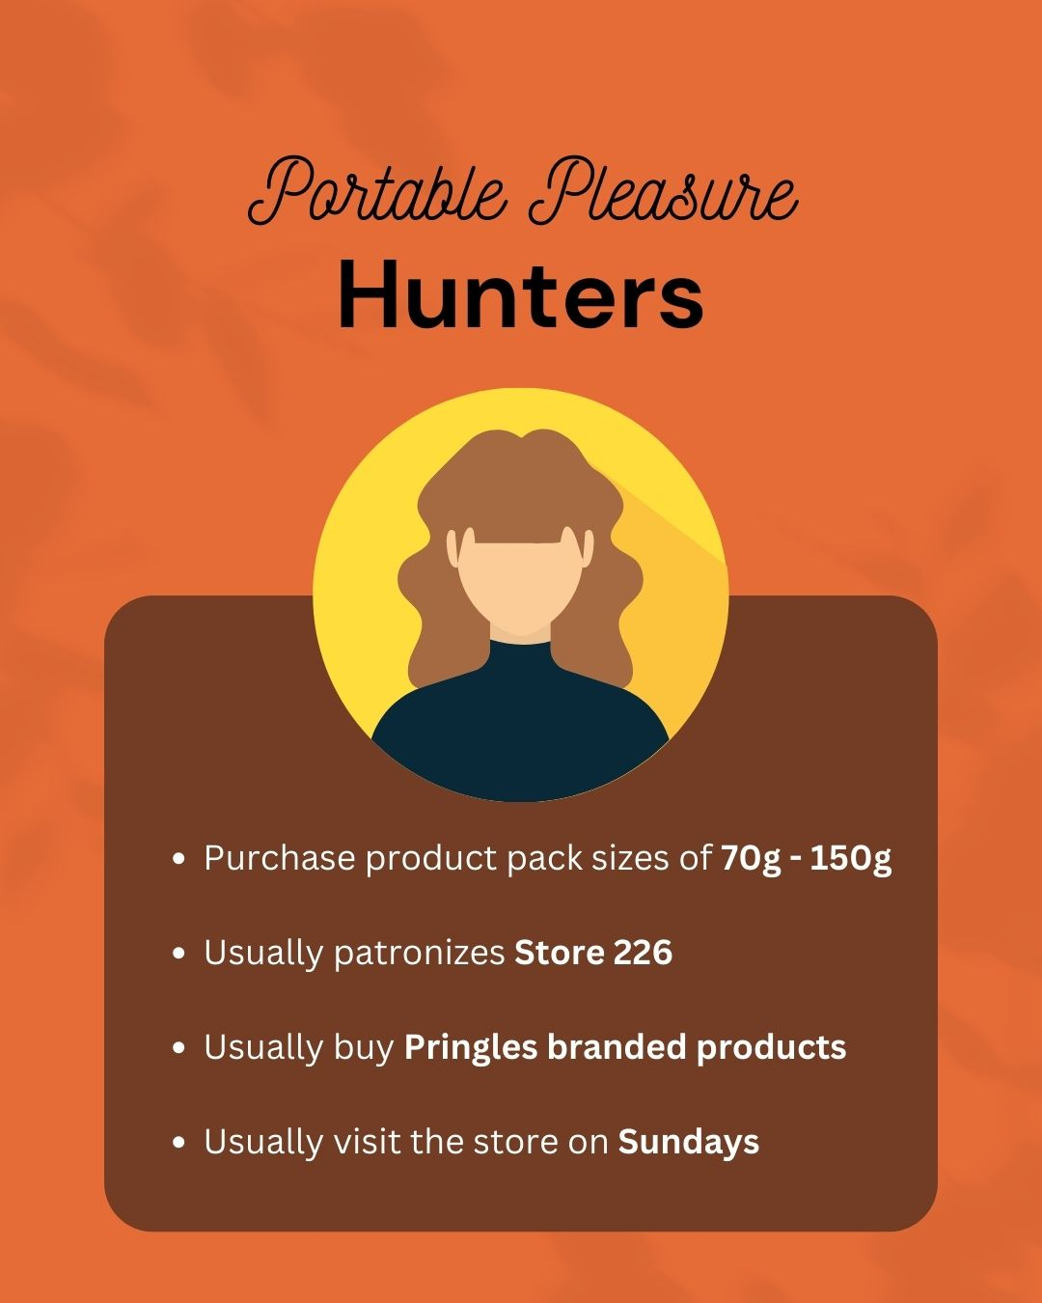

Slide 10
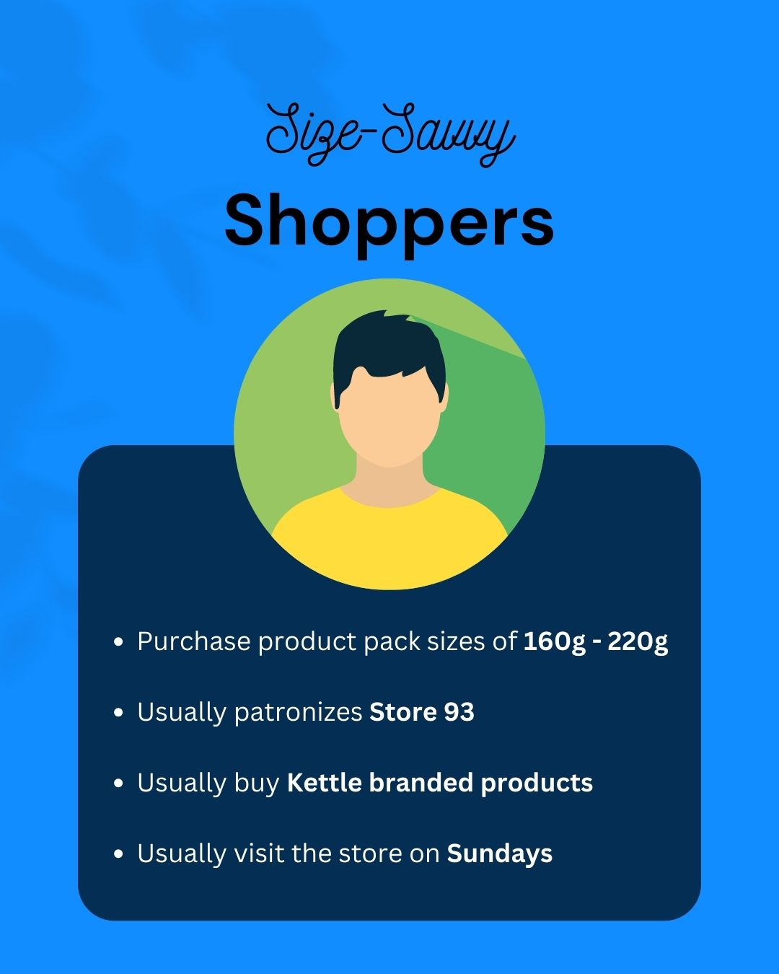

Slide 11
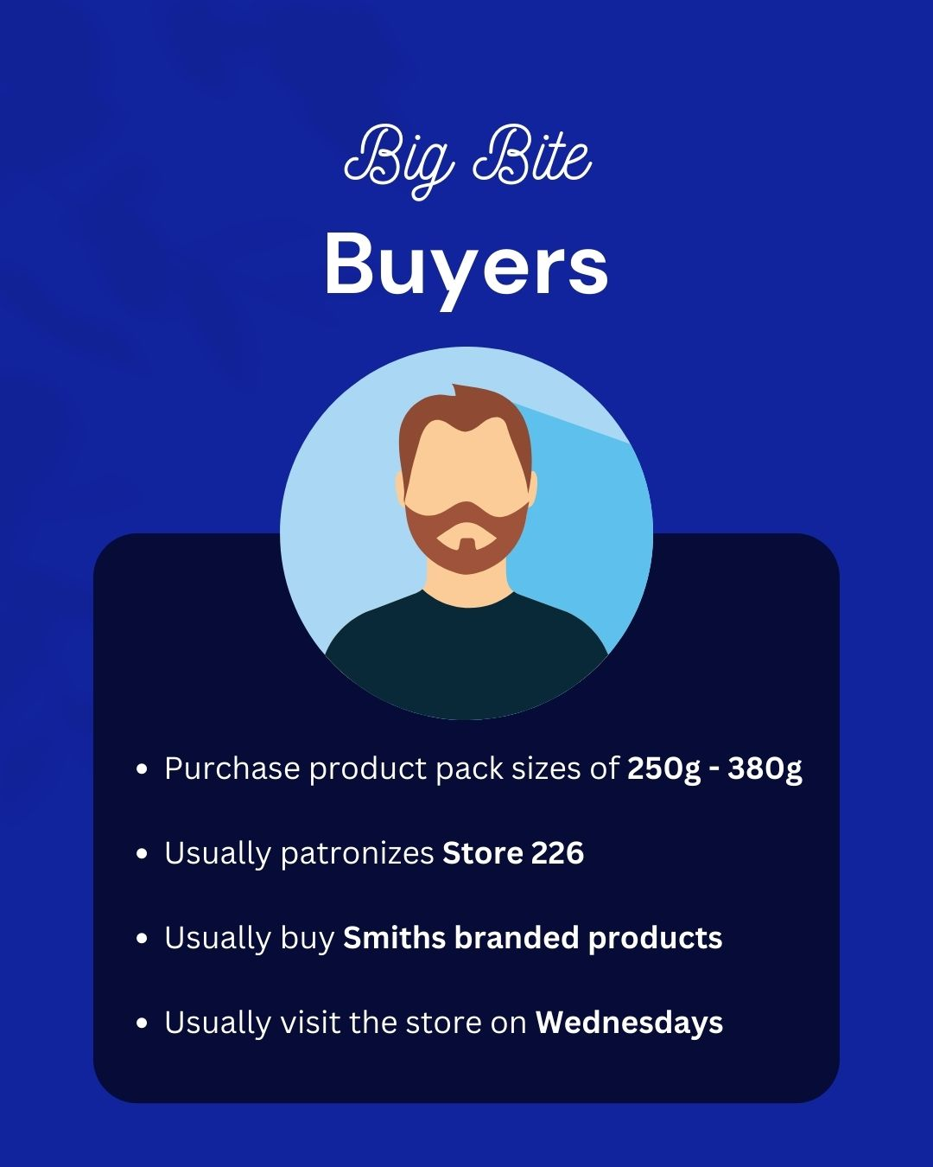

Slide 12
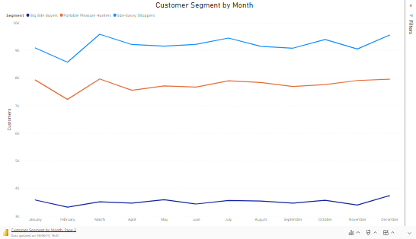
Different segments, similar behavior
All segments dip their purchases in February and picks up purchases in March. Then there’s gradual purchases filled with highs and lows until July when it dips again and picks up again in October. Then it dips a final dip of the year and rises in December. Portable pleasure hunters and Size-savvy shoppers had sharp peaks and dips unlike Big bite buyers that had a sluggish movement.
We’ll be evaluating the magnitude of each customer segments in the next slide.

Slide 13
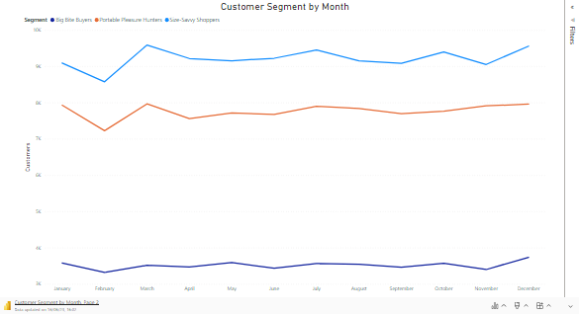
Portable pleasure hunters churn rate is unusual
Of all the customer segments, portable pleasure hunters is the one with the highest churn. Size-savvy shoppers are the majority of our customers and based on the effect of size and magnitude, they were expected to have the highest churn but instead portable pleasure hunters took the lead in churn rate due to its almost parallel line after March.
Something is definitely wrong. Why are portable pleasure hunters leaving faster than usual?

Slide 14
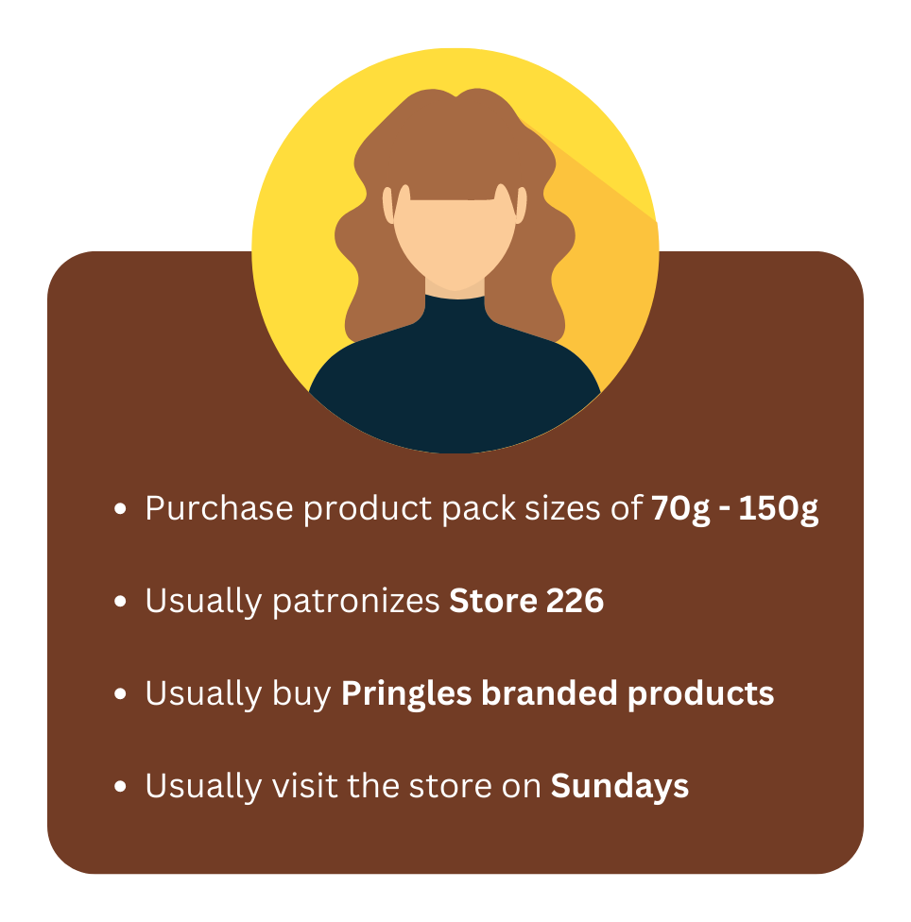
Our products might be too expensive for portable pleasure hunters
The portable pleasure hunters purchase pack sizes of 70g – 150g and patronize the store mostly on Sundays. This could mean that they are working class citizens that are still struggling to survive and can only afford to buy products In small sizes to manage their money.
If we want them with us, then we need to consider making their most preferred products affordable.

Slide 15
Conclusion
Revenue and customer growth are fast reducing over the years
Our customers are divided into portable pleasure hunters, size-savvy shoppers, and big bite buyers
Our customers have similar purchases patterns. Sales is usually at its peak every December of the year.
Portable pleasure hunters as the most leaving customers is unusual. They are probably leaving because they can’t afford our products any longer

Slide 16

Further investigate the reasons behind the churn of portable pleasure hunters using surveys and interviews
Develop targeted marketing campaigns for each customer cluster based on their preferences and buying patterns.
Explore partnerships or collaborations with complementary brands or retailers to expand our product range and offer more affordable options to customers.
Conduct a comprehensive analysis of sales patterns throughout the year to understand the drivers behind peak sales in December. Leverage this information to develop targeted marketing campaigns and promotions during this period to maximize sales potential.
Implement personalized marketing strategies, such as targeted email campaigns or personalized product recommendations, based on the preferences and purchasing history of each cluster.
What can be done?
Efforts should be targeted at retaining customers across all segments especially the portable pleasure hunters

Slide 17

Thank You
Twitter:
@AmandiNancy
LinkedIn:
Nancy Amandi
Nancy Amandi

